Slide 1
You've invested a lot of money on an IT Asset Management solution. AssetTrack ensures you get your money's worth.

Slide 2
Introduction Tom Watson, CEO of AMI
Tom Watson
206.898.6130 – direct
tom.watson@amitracks.com
linkedin.com/in/tomwatsonami
amitracks.com

Slide 3
AMI Customers
These enterprises rely on AMI to support asset management.

Slide 4
Considering this solution?
Notes:
Does AMI AssetTrack makes sense for you?

Slide 5
"We're gonna need a bigger boat."
Efficient and accurate data capture
Validation and exception management
Seamless integration with the repository
Notes:
Have you outgrown your current system?

Slide 6
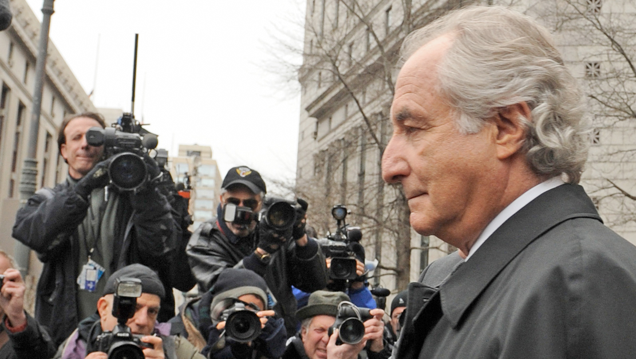
Not Trustworthy
Efficient and accurate data capture
Validation and exception management
Seamless integration with the repository
Notes:
Can you trust its accuracy?

Slide 7
Certified for use with...
Notes:
CA and HP both use AssetTrack at their data centers

Slide 8
What do companies want?
Accurate Data Capture
Accessibility to Data
Measurable Results

Slide 9
The only thing
constant is change
Maintaining data is a process, not an event

Slide 11
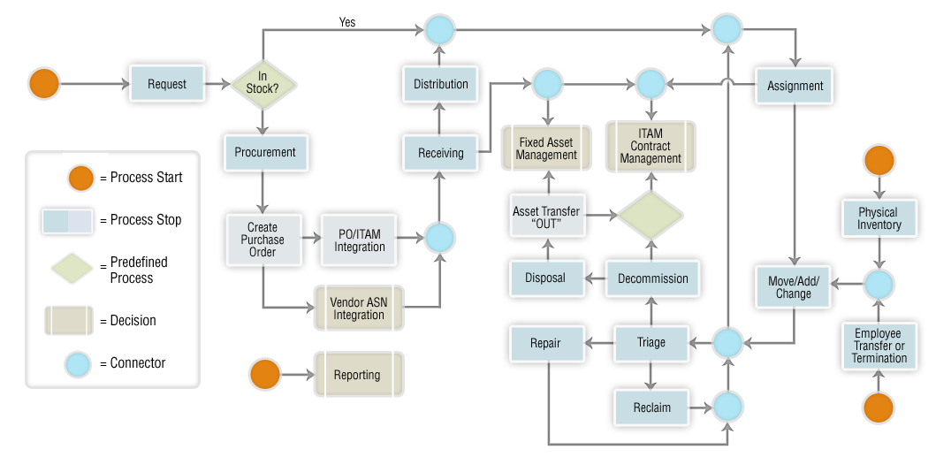
The Asset Lifecycle

Slide 12
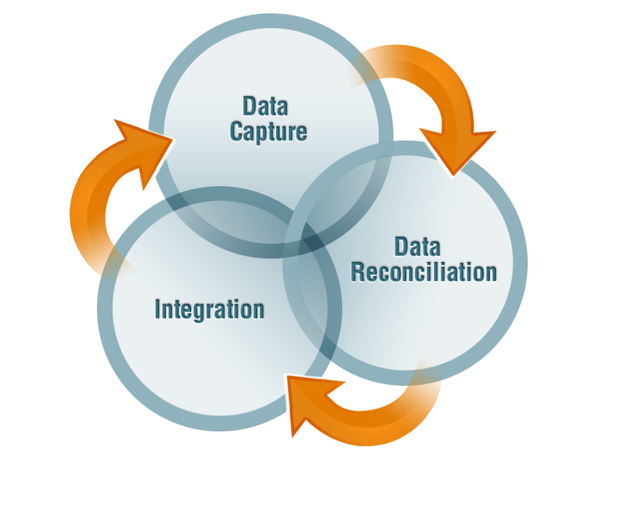
AssetTrack Software
Notes:
Key drivers

Slide 13
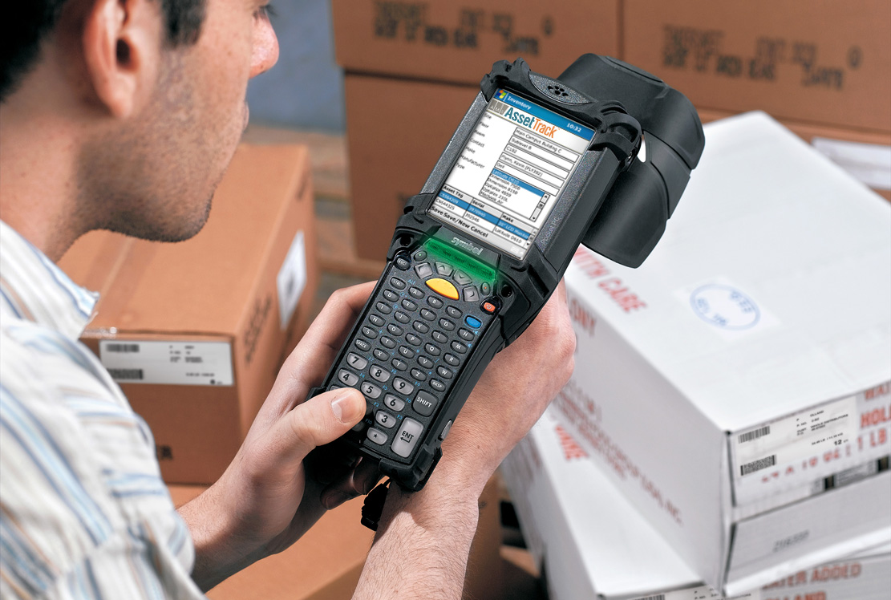
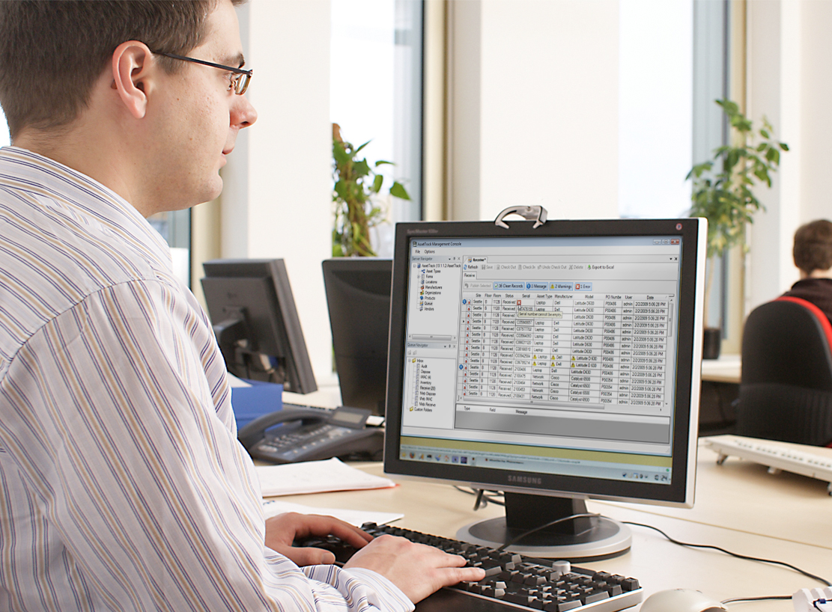
Three Levels of Users
AssetTrack does the right thing for the right people at the right time.
Notes:
Field level, asset manager, CFO

Slide 14
AssetTrack is Smart
Notes:
Quick and accurate

Slide 15
AssetTrack is Smart
Notes:
Catches errors before they can be added to database

Slide 16
AssetTrack is Smart
Notes:
Provides audit trails and ROI reports

Slide 17
Notes:
Integrates all vital functions

Slide 18
Automation of Data Capture
Notes:
Works with any combination of RFID and barcoding tagging

Slide 19
Training and Support

Slide 20
Eliminates Manual Data Entry

Slide 21
Notes:
Tracks warranties, leases and service contracts

Slide 22
Asset Managers

Slide 23
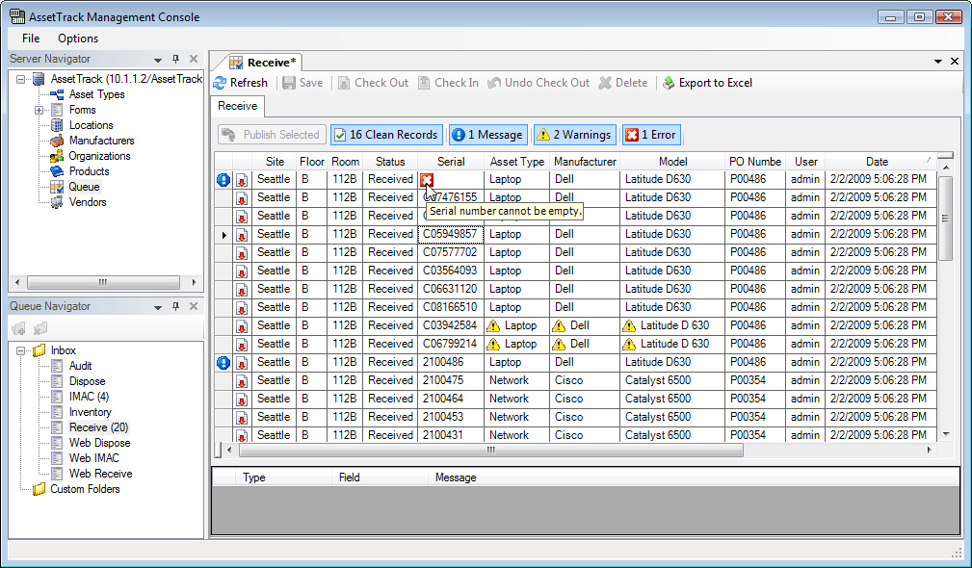
Data Validation for Asset Managers
Automatically detect problems with collected data to prevent database corruption

Slide 24
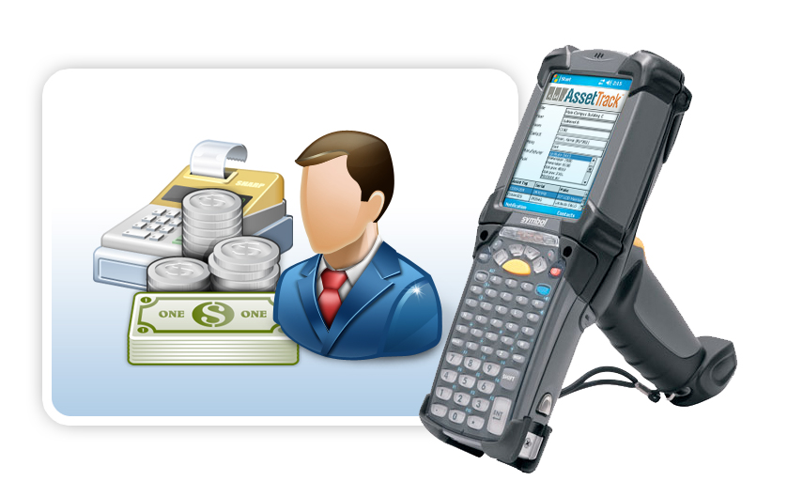
Executive Suite
Notes:
Provides accurate information vital to decision making

Slide 25
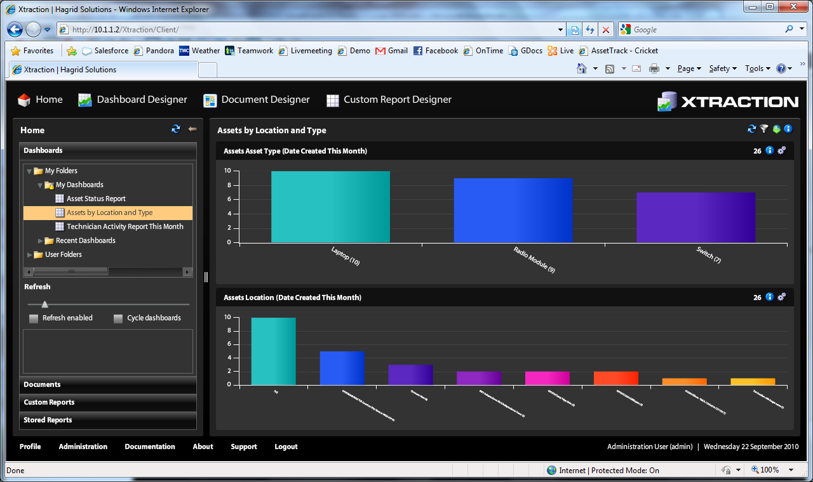
Auditing for the Executives
Log and monitor all user activity to ensure compliance with established ITAM processes.

Slide 26
Return On Investment
Notes:
AssetTrack can prove its ROI

Slide 27
Customization for Solution Architects
Easily customize the solution without software development expense.

Slide 28
Inventory Control
Model Number
Purchase Order
Location
Serial Number
Warranty Date
Lease Details
Notes:
Automatically captures all essential data

Slide 29
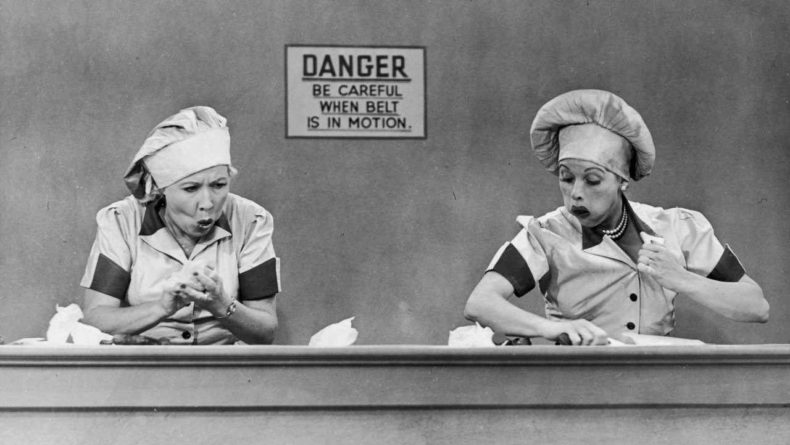
AssetTrack is Smart
Notes:
Eliminates common human errors

Slide 30
Screen

Slide 31
Screen

Slide 32
Streamlined
Notes:
Never a need to stop gathering data collection for exceptions

Slide 33
How is AssetTrack so smart?
Notes:
Defines what information needs to be captured

Slide 34
Never Forgets
Notes:
Every activity is logged

Slide 35
Example
Notes:
Within 6-9 months United’s system was in great shape

Slide 36
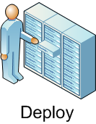
Data Capture Example
Automate asset data capture through the entire lifecycle

Slide 37
Barcode Data Capture for Field Users
Notes:
Locations can be recorded in an instant

Slide 38
Screen

Slide 39
AssetTrack knows
Notes:
Makes fixing discrepancies quick and easy

Slide 40
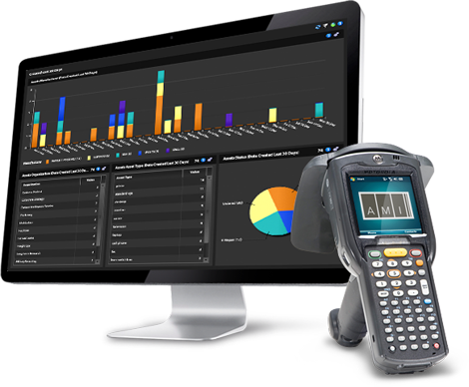
Reporting Capabilities
Notes:
Intuitive and easily configured reports

Slide 41
AssetTrack is Smart

Slide 42
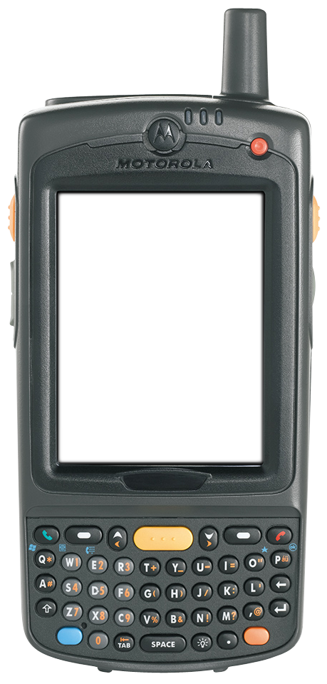
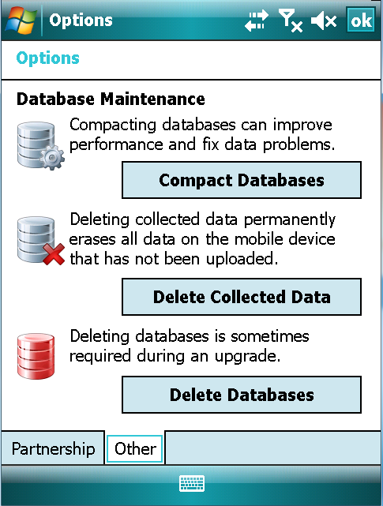
Integration
People
Processes
Technology

Slide 43
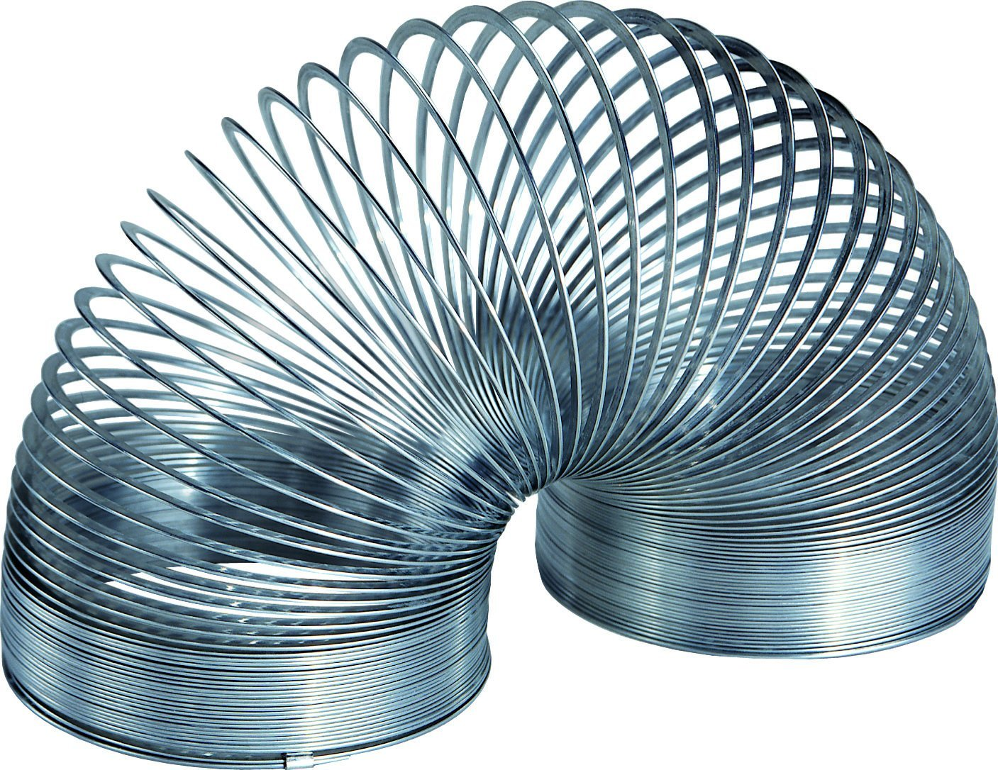
AssetTrack is flexible

Slide 44
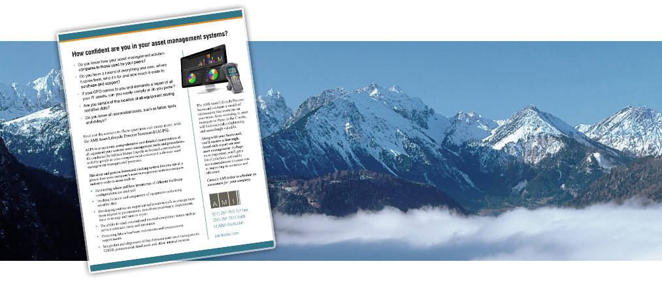
Asset Lifecycle Process Scorecard
ALPS
Notes:
Shows how you compare to others in the industry

Slide 45
Asset Lifecycle Process Scorecard
Notes:
A great first step

Slide 46
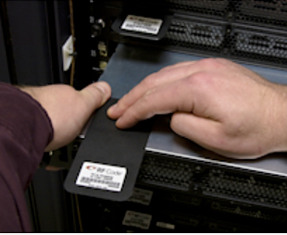
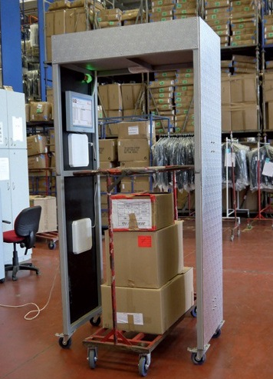
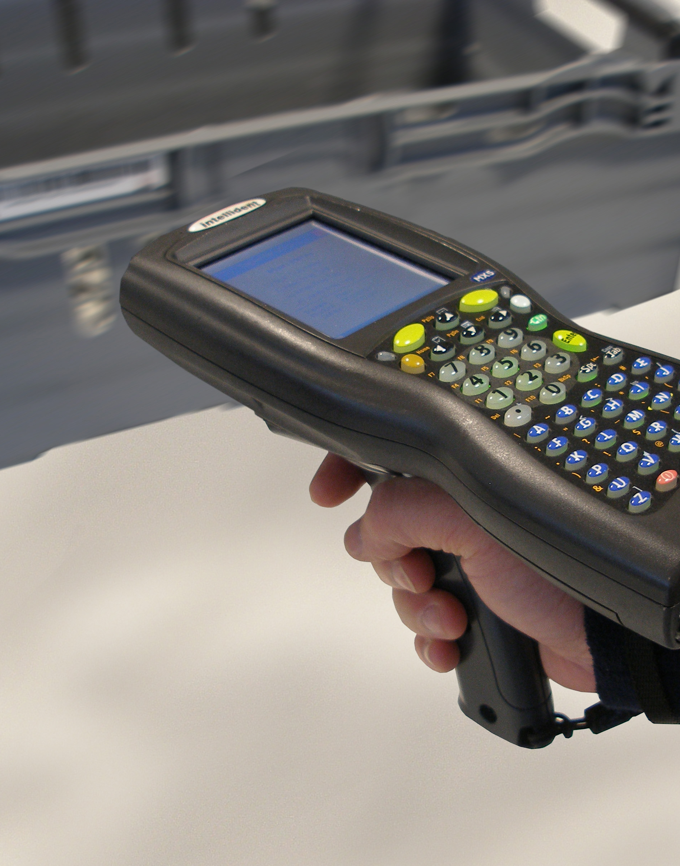
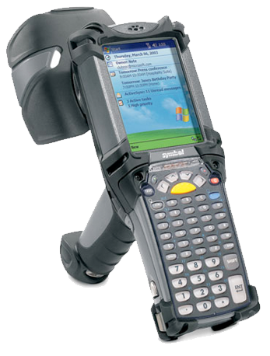
Achieve the greatest ROI

Slide 47
Return On Investment

Slide 48
Business Partner

Slide 49
Long-term Relationship

Slide 50
Getting More Information
Web: amitracks.com
Phone: (877) 297-7618
Email
Sales: sales@amitracks.com
Partners: partners@amitracks.com
Support: support@amitracks.com
Presenter
Thomas Watson: tom.watson@amitracks.com
President & CEO, Co-founder

